Slide 1

Customer Shopping Behavior Analysis
Uncovering insights from transactional data to guide strategic business decisions.

Slide 2

Project Overview
Data Source
Key Goals
3,900 purchases across categories.
Spending patterns, segments, preferences, subscriptions.
Outcome
Guide strategic business decisions.

Slide 3

Dataset Summary
Key Features
Customer demographics
Purchase details
Shopping behavior
Data Size
3,900 Rows, 18 Columns

Slide 4

Exploratory Data Analysis (Python)
01
Data Preparation
Loading, initial exploration, missing data handling.
02
Column Standardization
Renamed to snake case for readability.
03
Feature Engineering
Age groups, purchase frequency.
04
Database Integration
Cleaned data loaded to SQLite for SQL analysis.

Slide 5

Data Analysis (SQL)
1
Revenue by Gender
Male: $157,890, Female: $75,191
2
High-Spending Discount Users
Customers using discounts, spending above average.
3
Top 5 Products by Rating
Gloves, Sandals, Boots, Hat, Skirt.
4
Shipping Type Comparison
Express: $60.48, Standard: $58.46 (Avg. Purchase)

Slide 6

SQL Analysis: Subscribers & Discounts
Subscribers vs. Non-Subscribers
Discount-Dependent Products
Yes
1053
59.49
62645
Hat (50%)
Sneakers (49.66%)
No
2847
59.87
170436
Coat (49.07%)
Sweater (48.17%)
Pants (47.37%)

Slide 7
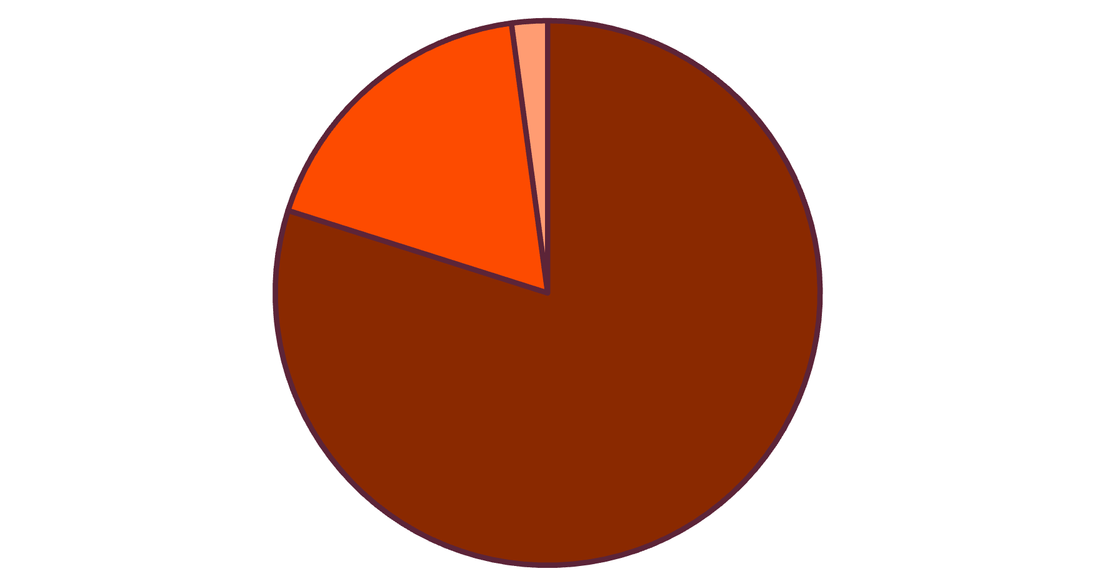

Customer Segmentation & Top Products
Customer Segments
Top Products per Category
Accessories: Jewelry, Sunglasses, Belt
Clothing: Pants, Blouse, Shirt
Footwear: Sandals, Shoes, Sneakers
Outerwear: Jacket, Coat
Loyal
Returning
New

Slide 8
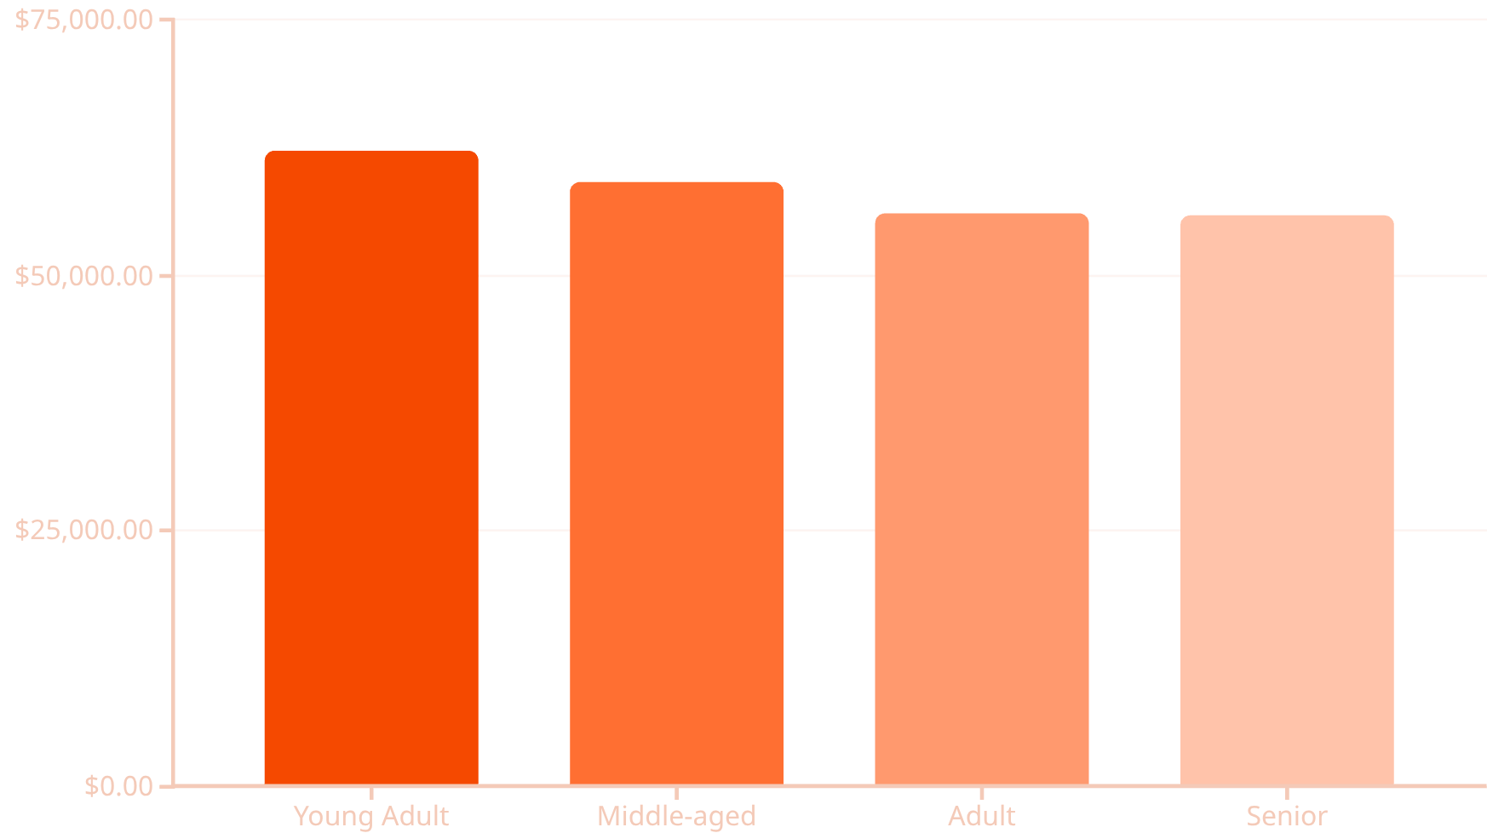

Repeat Buyers & Age Group Revenue
Repeat Buyers (>5 purchases)
Revenue by Age Group
Subscription Status:
No: 2518
Yes: 958

Slide 9
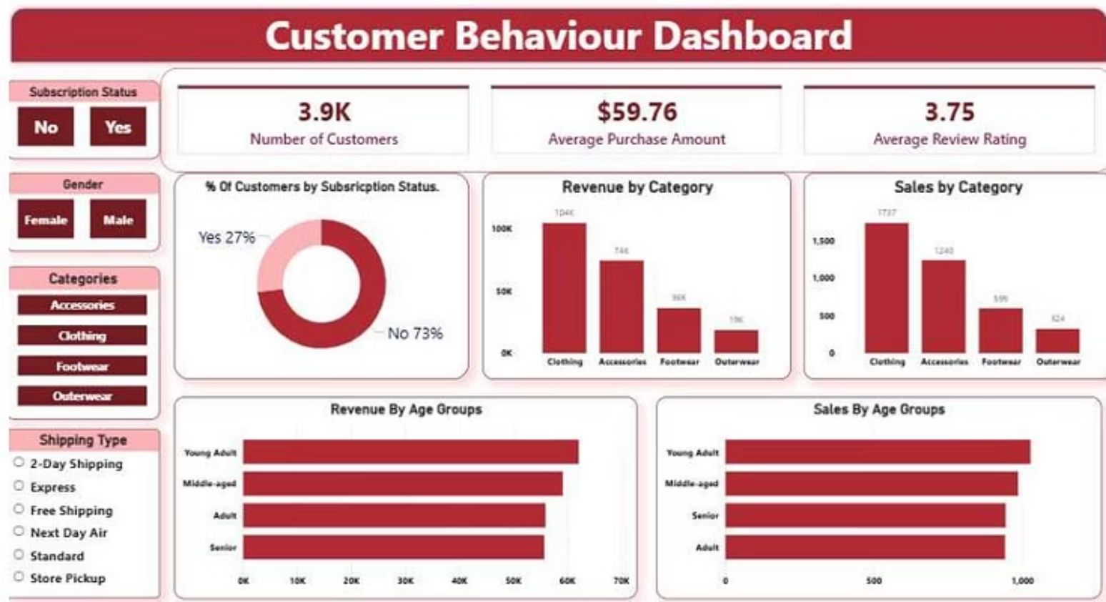

Power BI Dashboard Insights
3.9K Customers
$59.76 Avg. Purchase
3.75 Avg. Review

Slide 10
Business Recommendations
Boost Subscriptions
Promote exclusive benefits.
Customer Loyalty
Reward repeat buyers.
Review Discount Policy
Balance sales with margin.
Product Positioning
Highlight top-rated items.
Targeted Marketing
Focus on high-revenue groups.

